Slide 1

Segment Runner
Gravity Guyz
Arash Shariatzadeh, Faheem Quazi, Zain Bhatti, Gabriel Torres

Slide 2

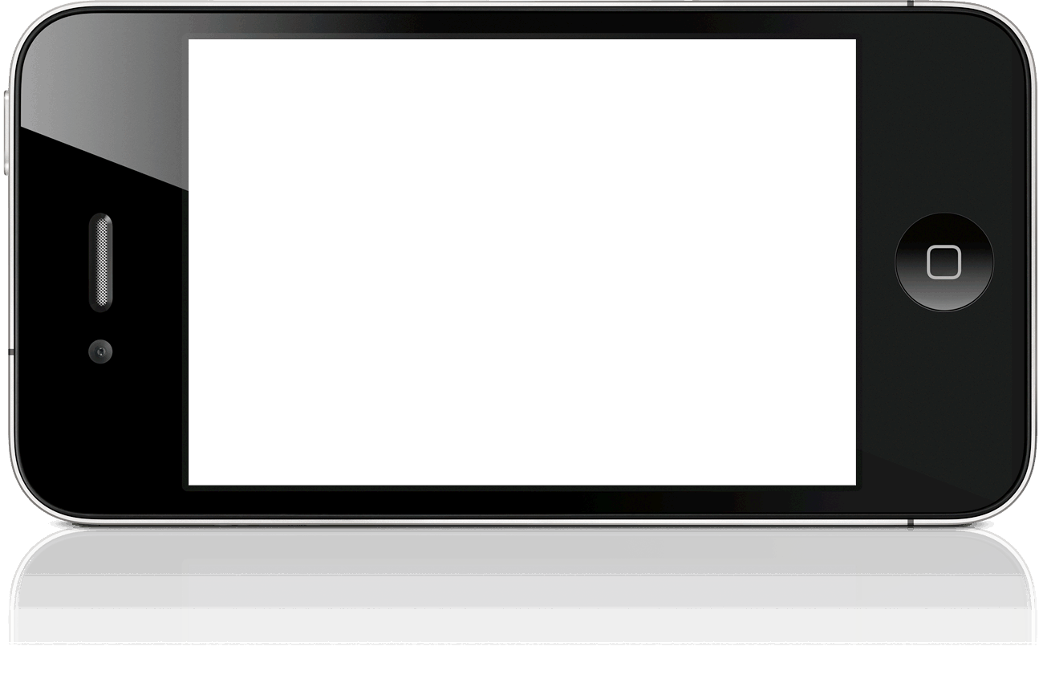
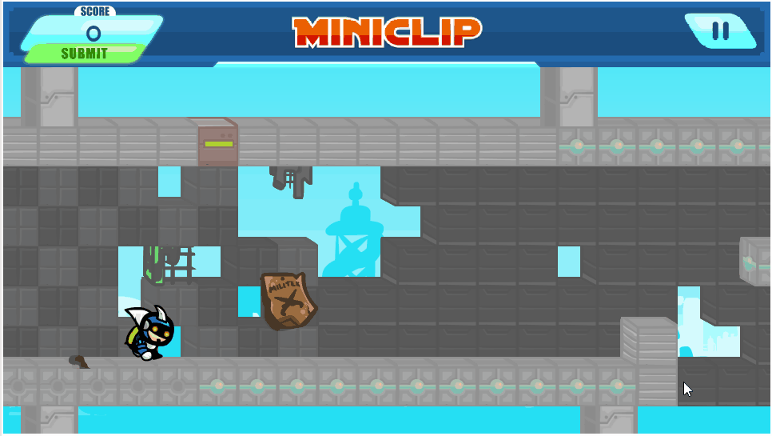
Inspiration
Inspired by the 2010 mobile game, Gravity Guy
Notes:
Gabriel
**Arash Included This** Change if you need or add more stuff. Developer is Miniclip Games. Available in iOS, Android, Windows Phone, Nokia Symbian OS, and PC through flash. Our Segment Runner game has the same mechanics of running through the floor and ceiling as if the player could control gravity with the added feature of the stage being randomly generated unlike Gravity Guy, which has premade stages.

Slide 3

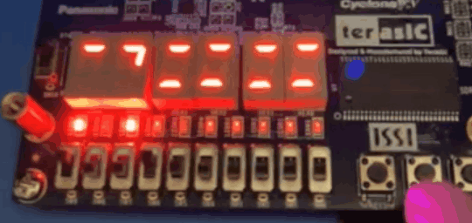
Our Game
An endless runner platformer game
Floor and ceiling tiles are randomly generated on the 7-segment displays from right to left
User must press button to move player from floor to ceiling, or ceiling to floor to avoid landing on empty tiles
If the player lands on an empty floor or ceiling tile, the game ends
Notes:
Zain
Just as in the original, our game is an endless runner platformer game where floor and ceiling tiles are randomly generates and displayed on the 7-segment displays of our FPGA board. In the video we can see that the newly generated floor and ceiling tiles come in from the right side and propagate to the left to simulate the player moving forward to the right side. The player is represented by the single vertical segment of the second 7-segment display from the right. The user must press the gameplay button to make their player “jump, that is move from either the floor to the ceiling or the ceiling to the floor in an effort to avoid the empty tiles. If the player lands on or “steps” on an empty tile the game ends. The objective of the game is to see how far the player can last without touching an empty tile, where the player’s score is based on how far they reached before the game ended.

Slide 4
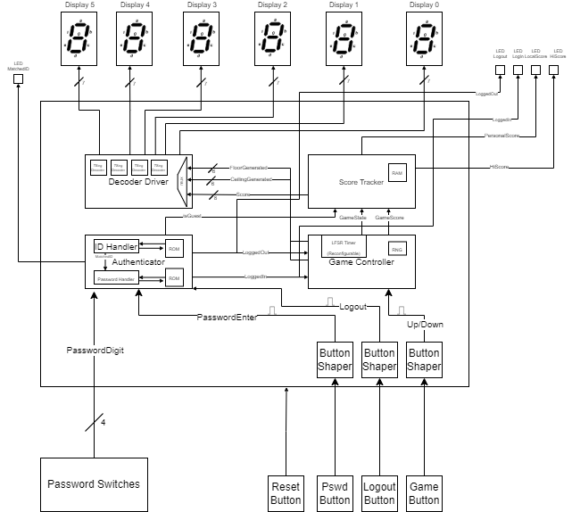
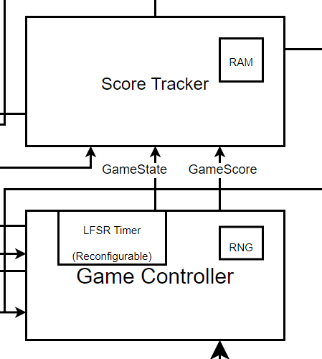
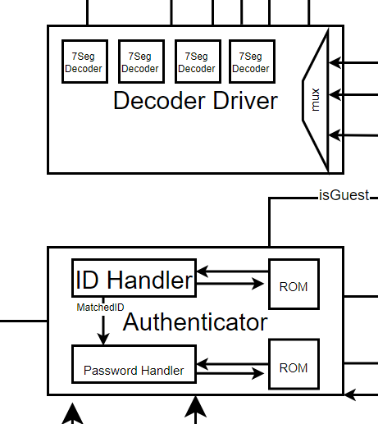
System Overview
Notes:
Arash
This game is comprised by four main modules. Starting with the Authenticator module that features two layers of authentication: a 4-digit user ID, which is handled by our ID handler module, and a password handler module, the password has six hexadecimal digits

Slide 5
Key Features
High modularity codebase
Dynamic Autogenerated Gameplay
Unique state-based 7-Segment Decoder
Notes:
Zain
For this game, we came up with three key features that we wanted to accomplish. The first is a high modularity codebase, which would allow all of us to develop independent of each others work. The second was dynamic autogenerated gameplay, which would allow us to create completely random scenarios in real time, and not depend on storing large levels in registers or ROM. The third is a unique display decoder, which takes full advantage of the way 7-segment displays operate to improve the efficiency, slack, and response time of our game.

Slide 6
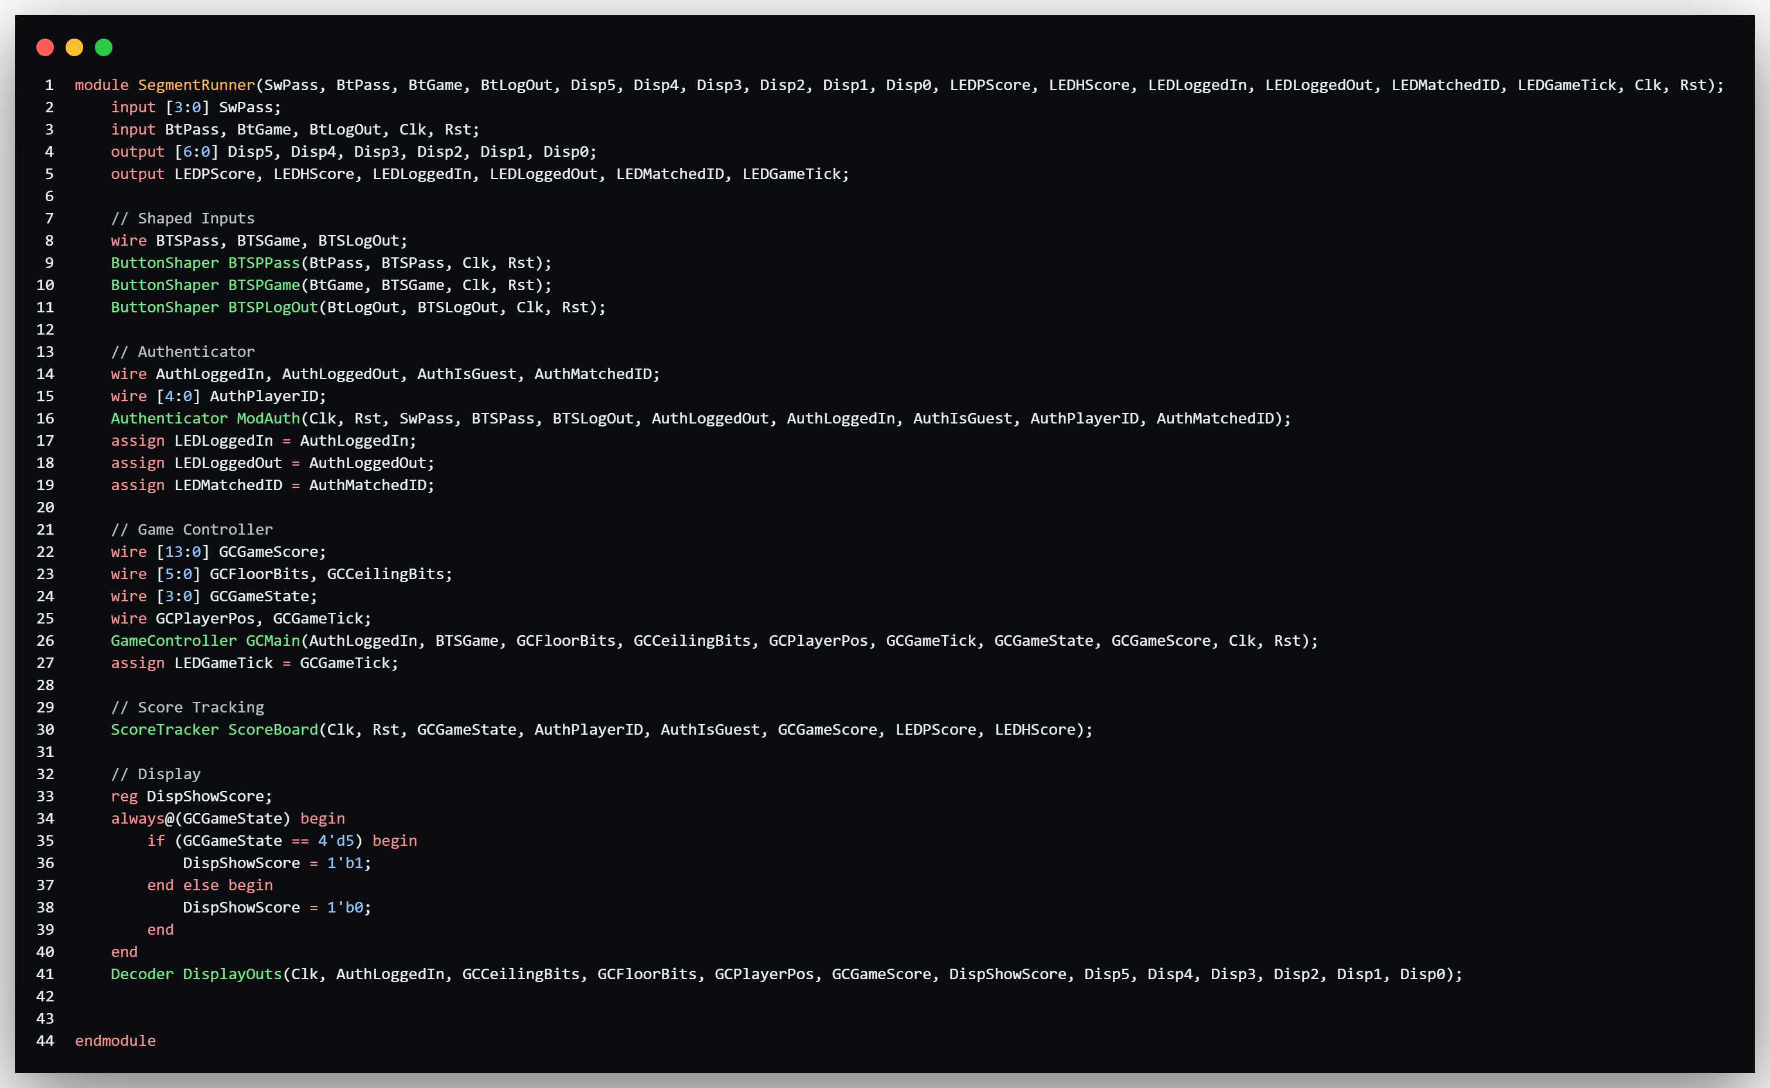








High Modularity Codebase
Four Teammates = Four unique workspaces
Integrated at top level module
Notes:
Faheem

Slide 7
Dynamic Autogenerated Gameplay
Partially emulates the real game behavior
As time progresses
speed increases
platform overlap decreases
Unique to our game
Platform change timing is pseudorandom (LFSR)
Platform layout is random
Notes:
Faheem

Slide 8
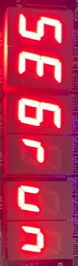
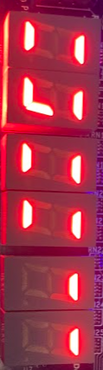
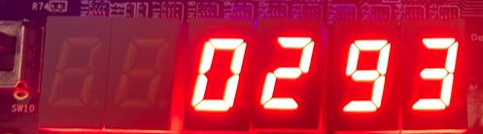
Unique State-Based 7-Segment Decoder
“SEGrun” when the user is logged off
All displays used during gameplay, with direct mapping to player position bit
First two displays turned off and last four displays show score when gameplay is over
Ceiling
Floor
Player
Notes:
Gabriel

Slide 9

DEMO

